Slide 1
Sniffing on Wireless LANs

Slide 2
Basic concept of wireless LAN
A type of local area network.
Use high frequency Radio Wave (RF).
Speed: 11Mbps to ~7Gbps.
Range: 20m to ~250m.
IEEE 802.11 family (See Wiki IEEE 802.11)
  802.11a
    5-6 GHz
    Up to 54Mbps

Slide 3
  802.11b
    2.4 GHz
    Up to 11Mbps
  802.11g
    2.4 GHz
    Up to 54Mbps
  802.11n
    2.4 / 5 GHz
    Up to ~600Mbps
Notes:
For your reference only

Slide 4
  802.11ac
    5GHz
    Up to ~1.3Gbps
  802.11ad
    60GHz
    Up to ~7Gbps
Notes:
For your reference only

Slide 5
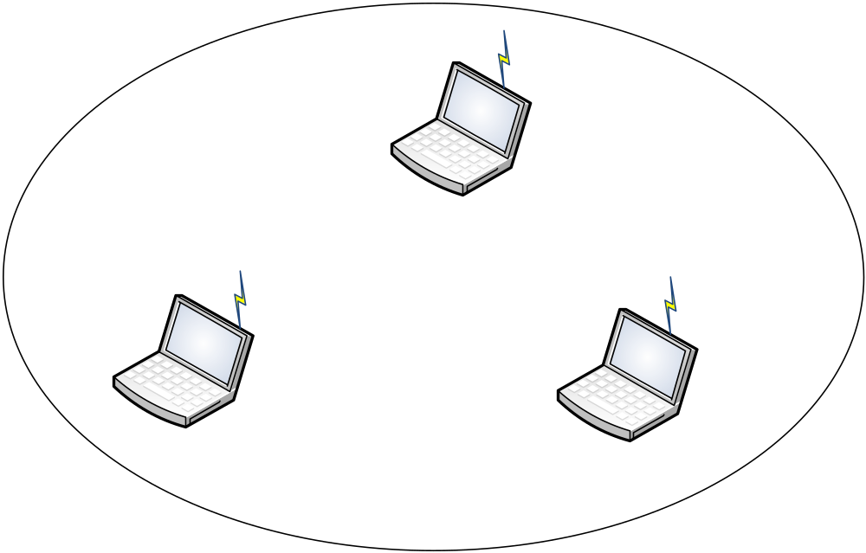
Ad Hoc Mode
  Client to client communication
  Wireless devices can directly communicate with each other
  No access point is needed

Slide 6
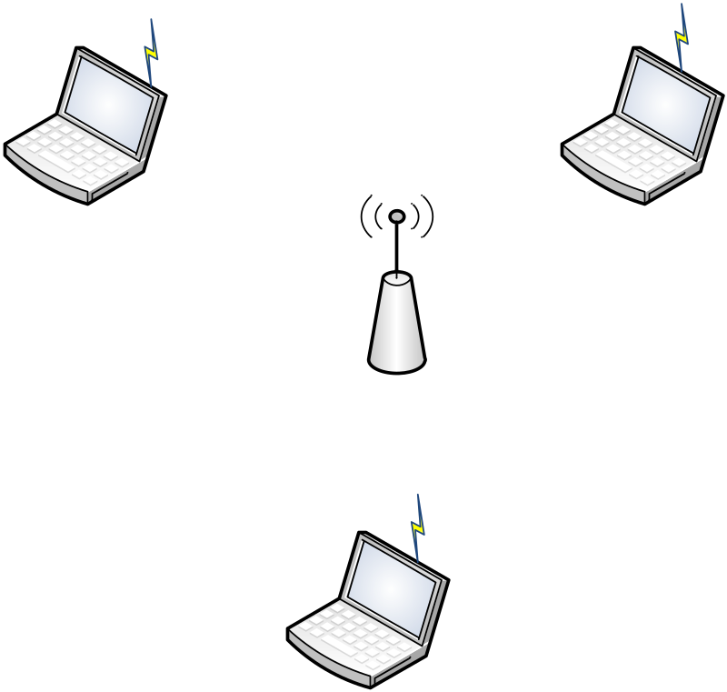
Infrastructure mode
  Connect to Access Point (AP)
  Most of the wireless networks are connected in this way.

Slide 7
Access Point (AP)
  Serves as a “hub” for wireless clients.
  Bridge between wired and wireless LANs.
  Similar to a basestation used for a cellular phone network.
Beacon
  A message transmitted at regular intervals by the APs.
  Used to maintain and optimize communications to automatically connect to the AP.
  Clients can join WLAN by
    listening to beacon passively, or
    sending a probe reply and wait for a probe response.
Notes:
Hub: repeat the data packet to ALL connected devices
Switch: only send the data packet to the target device

Slide 8
BSS (Basic Service Set)
  The set of clients and AP which have recognized each other and have established communications.
SSID or BSSID
  Basic service set identifier
ESS (extended services set)
  Series of overlapping BSS connected by a distributed system.

Slide 9
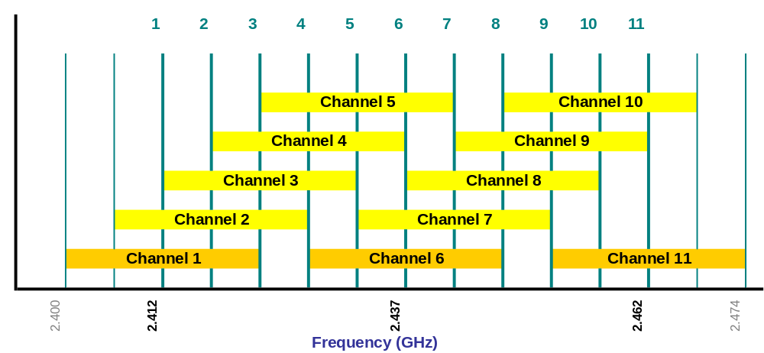
Channel
Source: http://www.pisa.org.hk/event/wlan_workshop.ppt

Slide 10
Encryption
Protect the message that is going to transmit
  Transform the message into unreadable information before sending it out
  Although the sniffer can still sniff the transmitted information, it is unreadable and the sniffer cannot get its meaning
The receiver needs to know how to decrypt the message
  Transform the unreadable information back to the original message
Important security measure, especially in wireless LAN

Slide 11
War Driving
Originally, War Driving was when crackers drove around in a car equipped with wireless gear looking for unsecured wireless networks, to gain illicit access.
Over time, the term has evolved to include harmless types that simply checking on the RF environment.

Slide 12
What are needed for war driving
  Device capable of
    receiving 802.11 signal.
    moving around.
  Software that will log data from the device.
    NetStumbler
Over time, you can build up a database comprised of the network name, signal strength, location, and ip/namespace in use.

Slide 13
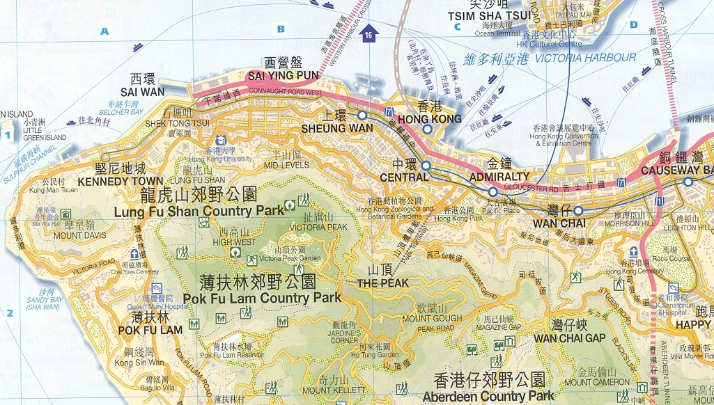
PISA tried her first war driving in Hong Kong on July 7, 2002
Their findings (in 2002)
  187 access points captured
  WEP enable: 22.99%
  WEP disable: 77.01%
Notes:
PISA: Professional Information Security Association
Ref: http://www.pisa.org.hk/event/wlan_workshop.ppt
WPA: 2003
WPA2: 2004

Slide 14
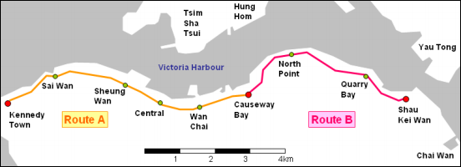
Their findings (in 2014)
  24,977 access points captured
  With Encryption: 76.74%
    WEP: 5.75% (considered broken, should not be used)
    WPA using TKIP: 23.80% (have a minor security issue)
    WPA using AES: 9.58%
    WPA2 using TKIP: 4.30%
    WPA2 using AES: 33.31% (most secure)
  Without Encryption: 23.26% (not secure)
Notes:
Source: http://www.safewifi.hk/files/2015/wd2014-report(v0.3).pdf
Practical attacks against WEP and WPA
http://dl.aircrack-ng.org/breakingwepandwpa.pdf

Slide 15
WEP Protocol
Wired Equivalent Privacy protocol is used in the original 802.11 network to protect link-level data during wireless transmission.
WEP relies on a secret key k shared between the communicating parties.
It is optional
  That means some users may not turn it on.

Slide 16
Plaintext
Message
CRC
XOR
Keystream= RC4(v,k)
v
Ciphertext
Transmitted Data
Notes:
v: Initialization vector (IV)
k: secret key
XOR:
0 XOR 0 = 0
0 XOR 1 = 1
1 XOR 0 = 1
1 XOR 1 = 0

Slide 17
Checksumming
  Compute an integrity checksum c(M) on the message M.
  Concatenate the two to obtain a plaintext
  P = <M,c(M)>
Plaintext
Message
CRC

Slide 18
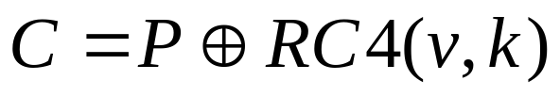
Encryption
  Choose an initialization vector (IV) v.
    IV must be different for every message transmitted.
    802.11 standard doesn't specify how IV is calculated.
    Wireless cards use several methods
      Some use a simple ascending counter for each message.
      Some switch between alternate ascending and descending counters.
      Some use a pseudo random IV generator.
  RC4 algorithm generates a keystream RC4(v,k)
    Long sequence of pseudorandom bytes
    A function of v and k.
  Exclusive-OR the plaintext with the keystream to obtain the ciphertext C:
Notes:
P: 0 0 1 1
RC4: 0 1 0 1
C: 0 1 1 0

Slide 19
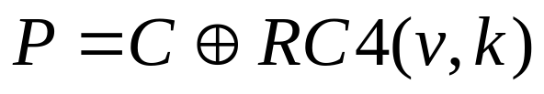
Transmission
  Transmit the IV and the ciphertext over the radio link.
Decryption
  Get the initialization vector (IV) v.
  Know the shared key k
  RC4 algorithm generates a keystream RC4(v,k)
  Exclusive-OR the ciphertext with the keystream to obtain the plaintext:
Notes:
P: 0 0 1 1
RC4: 0 1 0 1
C: 0 1 1 0

Slide 20
Weakness of WEP
Invariance weakness
  Existence of a large class of weak keys
    A small part of the secret key determines a large number of bits of the initial permutation.
    The patterns resulted from the weak keys propagate into the generated stream.
    The occurrences of these patterns in the secret key can be easily distinguished.
IV weakness
  Related key vulnerability
    When the same secret part of the key is used with numerous initialization vectors (which are exposed), the attacker can re-derive the secret part by analyzing the key-streams with relatively little work.
    The weakness exists in commonly used mode in RC4.
Presented in the paper
  Scott Fluhrer, Itsik Mantin, and Adi Shamir, “Weaknesses in the Key Scheduling Algorithm of RC4”.

Slide 21
Open-source implementations of the attack are now widely available.
One of the best-known programs is AirSnort.
  Some better tools can be found recently
    E.g. Aircrack-ng
    Crack WEP and WPA/WPA2-PSK (dictionary attack)
The bottleneck for key recovery is to gather weakly-encrypted frames.
Some reported that they can crack WEP in less than a minute.

Slide 22
802.11i
WEP is part of the original 802.11 standard. A new standard 802.11i should be used nowadays.
  Encryption
    Temporary Key Integrity Protocol (TKIP)
      Still based on RC4
      More complex scheme with message authentication, and longer IV (48-bit vs. 24-bit)
      Default encryption scheme for WPA
      Considered not secure, deprecated in 2012
    Counter Mode with CBC-MAC protocol (CCMP)
      A new protocol
      Uses AES as cryptographic algorithm
      More CPU intensive
      Default encryption scheme for WPA2
  802.1X Port-Based network Access Control
Notes:
Reference: 802.1X Port-Based Authentication HOWTO http://tldp.org/HOWTO/html_single/8021X-HOWTO/

Slide 23
  WPA/WPA2-Enterprise
    802.1X Port-Based network Access Control
    Authentication server
    Different users have different keys
  WPA/WPA2-PSK
    Pre-shared key / Personal
    The same key among all users
    A strong key should be used to avoid dictionary attack
      At least 12-14 characters
      Uppercase letters
      Lowercase letters
      Special characters
      Digits

Slide 24
Preventions Against Wireless LAN Sniffing and Other Attacks
Enable WPA2 using AES with a strong key (for PSK only)
Disable Wi-Fi Protected Setup (WPS).
  WPS provides an easy setup of a secure Wi-Fi network
  But a major security flaw is found in 2011
  According to PISA, in 2014, 34.08% of in the discovered routers have WPS enabled
Change the SSID and the administrator’s username/password regularly.
Hide SSID (disable network name broadcast)
Avoid using dynamic IP, or other intruders easily access the network.
Specify the authorized MAC addresses of the wireless NIC
Enable firewall functioning.
Use VPN (for encryption).

Slide 25
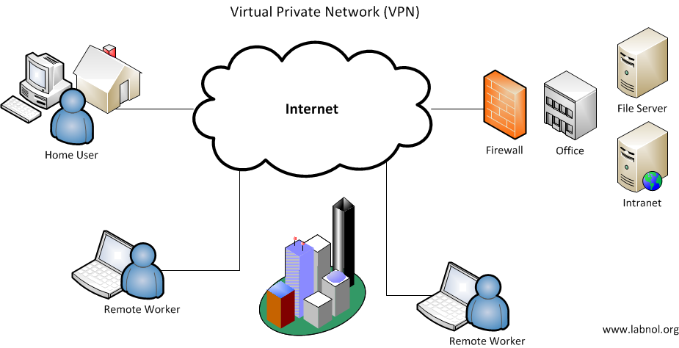
Virtual Private Network (VPN)
Build a private network on top of public connections
Image source:
Digital Inspiration http://www.labnol.org/software/setup-virtual-private-network-vpn/12208/
Notes:
Build a private network (e.g. CUHK network) on top of Internet (public network).
Home computers are considered as inside the CUHK network, even if their physical locations are outside CUHK.
Application
Some IT services require the computer to be in the CUHK network (e.g. download Kaspersky from the ITSC web page).
We cannot use these IT services directly at home.
Nevertheless, if our home computers (outside CUHK) are connected with CUHK VPN, the servers in CUHK will treat that our home computer are inside the CUHK network and allow us to use the services.

Slide 26
Client
Server
Application
Application
TLS/SSL
TLS/SSL
Transport
(TCP, UDP)
Transport
(TCP, UDP)
Router
Network (IP)
Network (IP)
Network (IP)
Network (IP)
(VPN)
(VPN)
802.11 Link
802.11 Link
Ethernet
Link
Ethernet
Link
WPA2/WPA/WEP
WPA2/WPA/WEP
Ethernet
Physical
Ethernet
Physical
Ethernet
Physical
Ethernet
Physical
Modified from http://www.pisa.org.hk/event/wlan_workshop.ppt

